Slide 1
Transaction Management

Slide 2
The problems associated with concurrently executing transactions
Concurrency is the ability of a database to allow a multiple users to affect multiple transaction.
Concurrency problem:

Slide 3
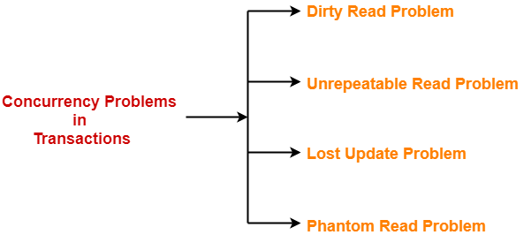
The problems associated with concurrently executing transactions

Slide 4

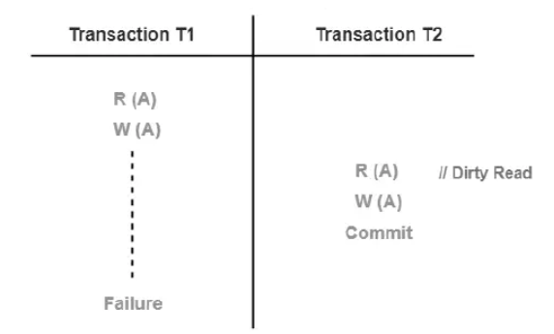
Dirty Read Problem:

Slide 5
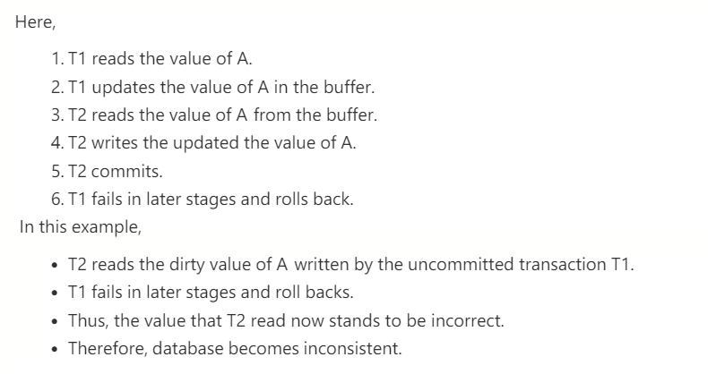
Dirty Read Problem:

Slide 6
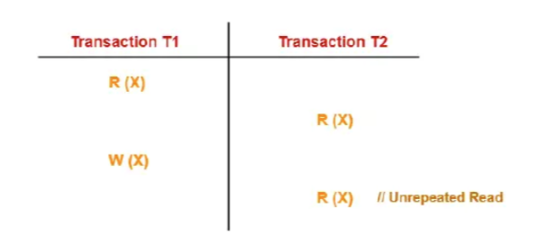
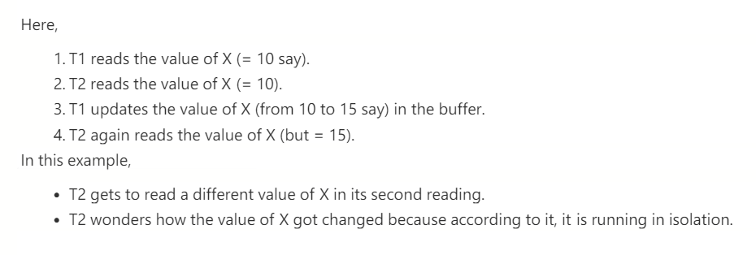
Unrepeated Read Problem:

Slide 7
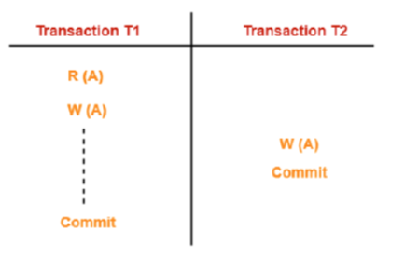
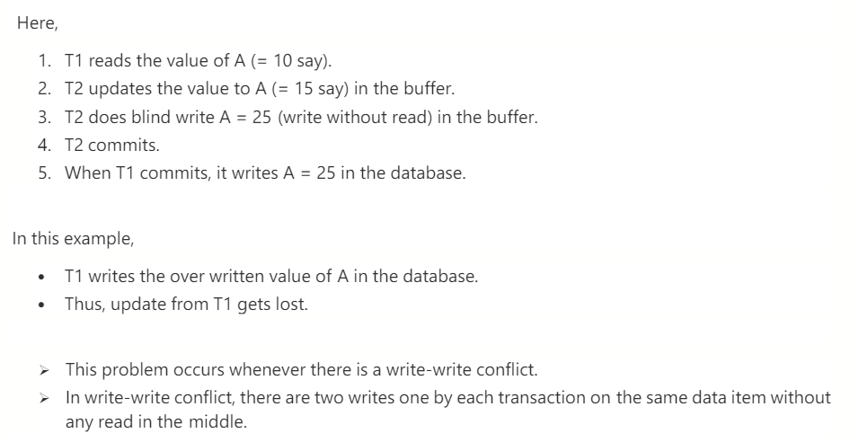
Lost Update Problem:

Slide 8
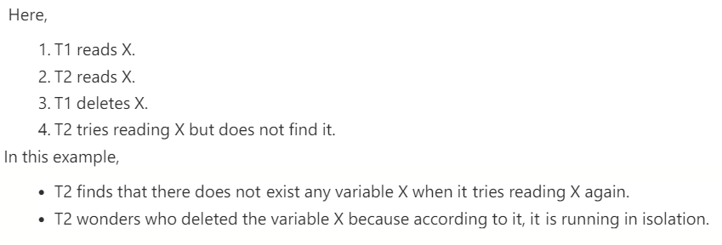
Phantom Read Problem:

Slide 9
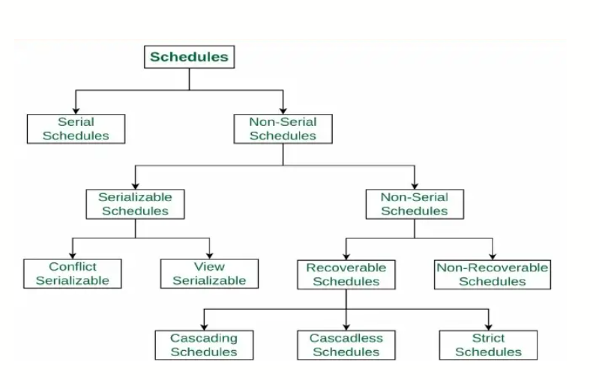
What is Schedule?
A schedule is a sequence that defines the execution order of operations for one or more concurrent transactions.

Slide 10

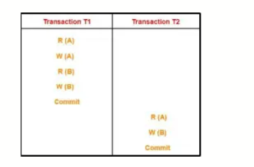

Serial Schedule:

Slide 11
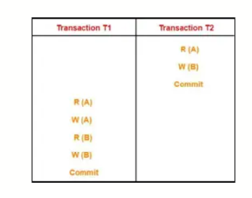

Serial Schedule:

Slide 12

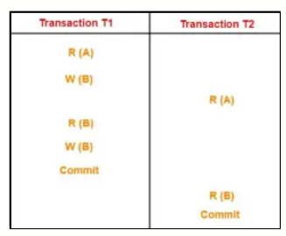

Non-Serial Schedule:

Slide 13
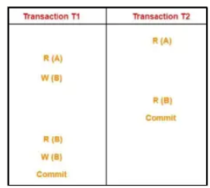

Non-Serial Schedule:

Slide 14


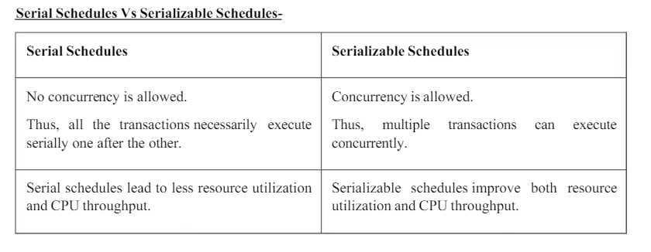
Serializability

Slide 15

Types of Serializability:

Slide 16

Conflict Serializable:

Slide 17
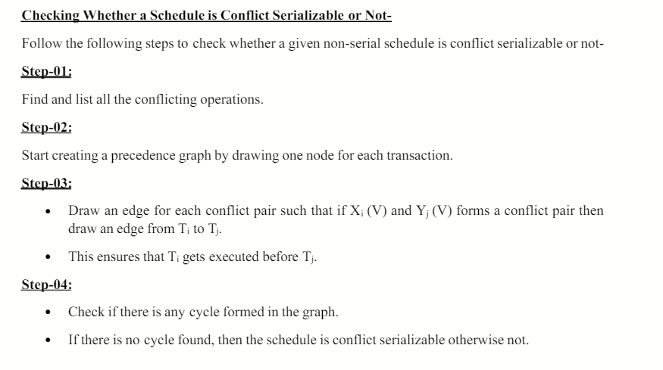
Conflict Serializable:

Slide 18
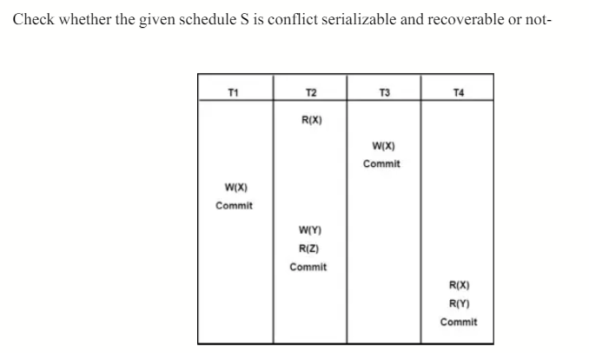
Conflict Serializable:

Slide 19
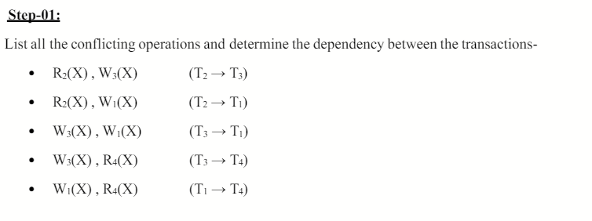
Conflict Serializable:

Slide 20
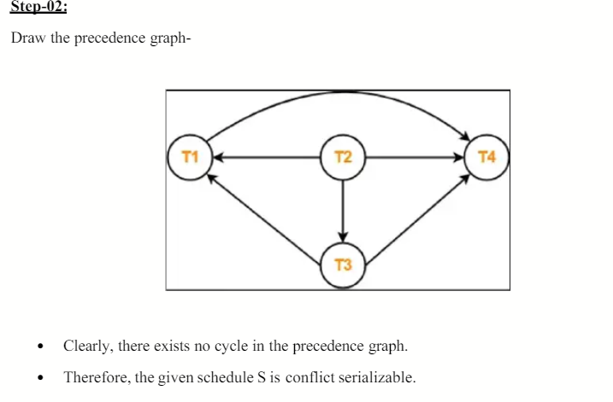
Conflict Serializable:

Slide 21
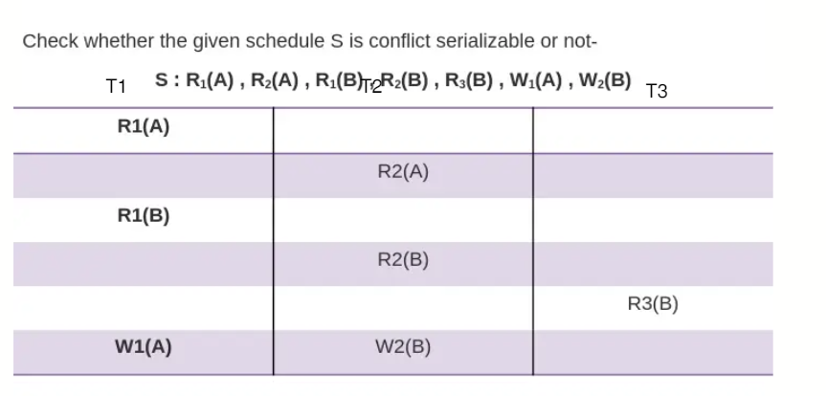

Example:

Slide 22
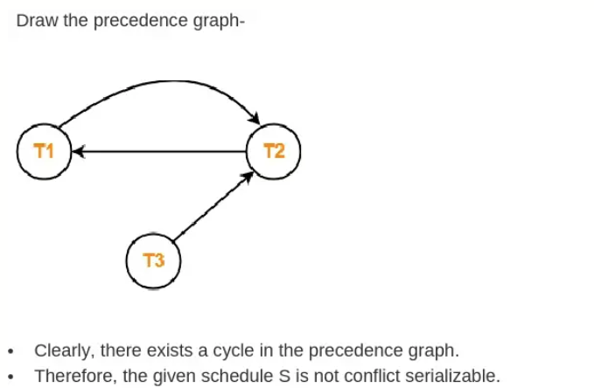
Example:

Slide 23
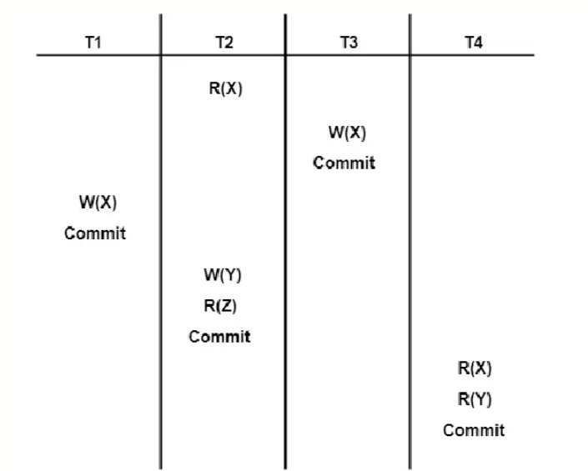
Example 2:

Slide 24
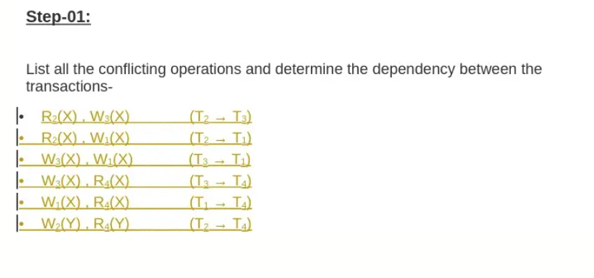
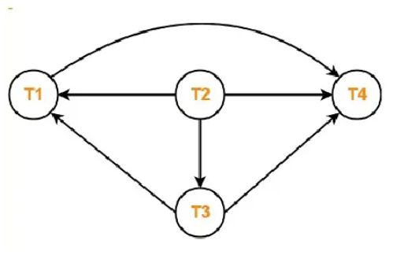
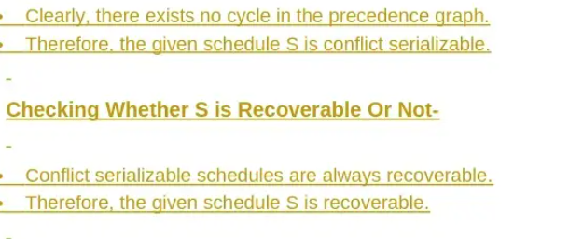
Example 2:

Slide 25
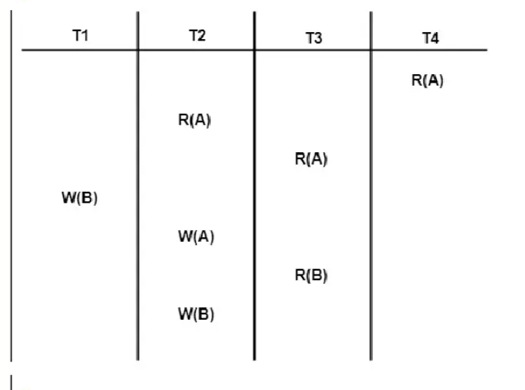

Slide 26
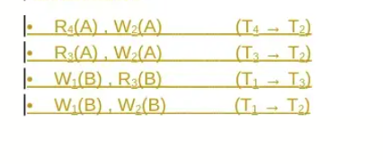

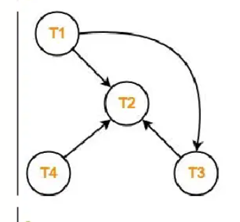

Slide 27
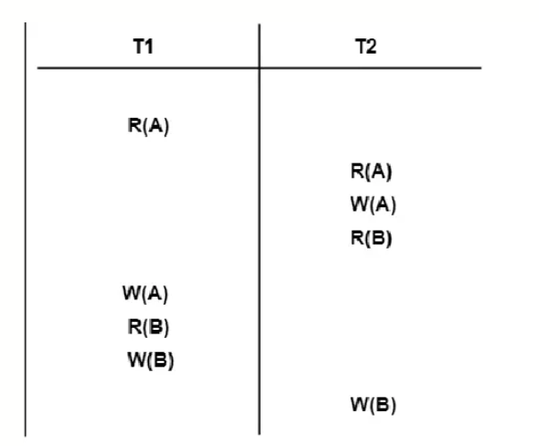

Slide 28
